Slide 1
Expedia Hotel Recommendation
Website: http://www.expediahotelrecommendation.com/
Team 10
Jun Wu,
Vishwa Shah,
Avinita Shetty

Slide 2
Problem Statement
Based on the dataset provided by Expedia, we are planning to achieve the following goals by performing multiple ways of data analytics, and comparing then applying data mining models.
Perform data exploration and extract meaningful information for business users
Predict which group of hotels the customer performing the search would likely to book.
Provide business users/ customers a user-friendly web access to observe data on web pages
For this we will be doing
MULTICLASS CLASSIFICATION

Slide 3
Data Exploration and Data Preparation
DATA EXPLORATION
Tools: Python, Alteryx and Tableau
Data Quality
Data Distribution
DATA PREPARATION
Create Dimensional Model
Handle Missing Values

Slide 4
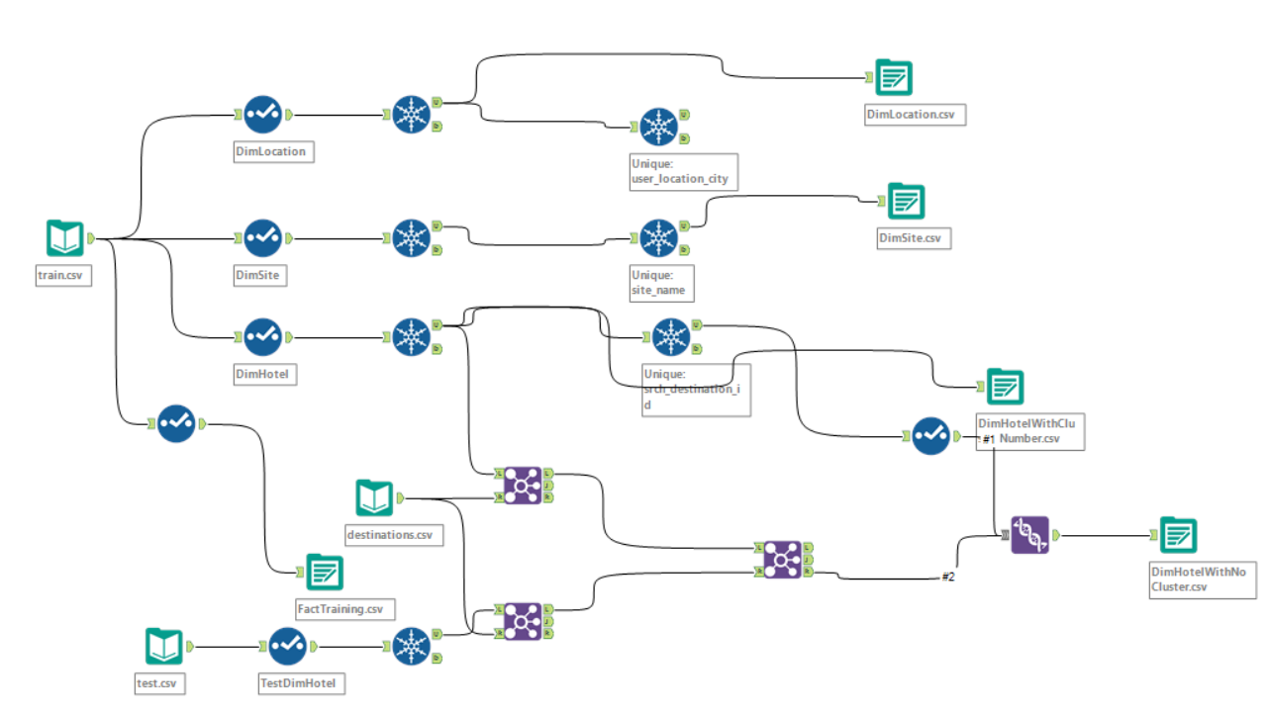
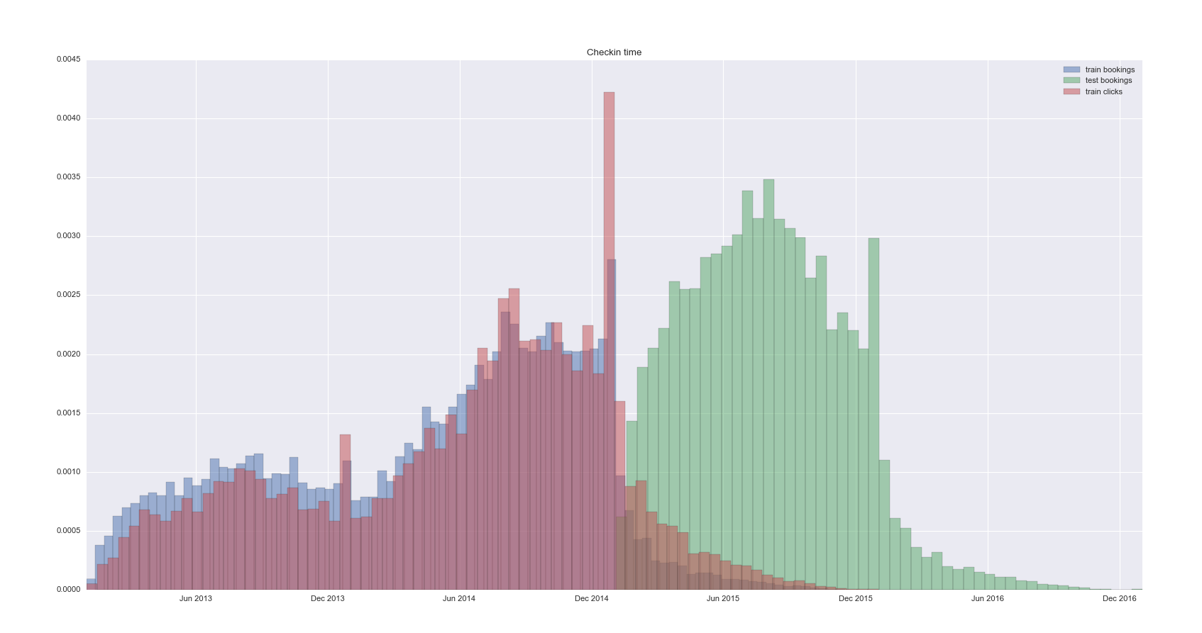

Slide 5
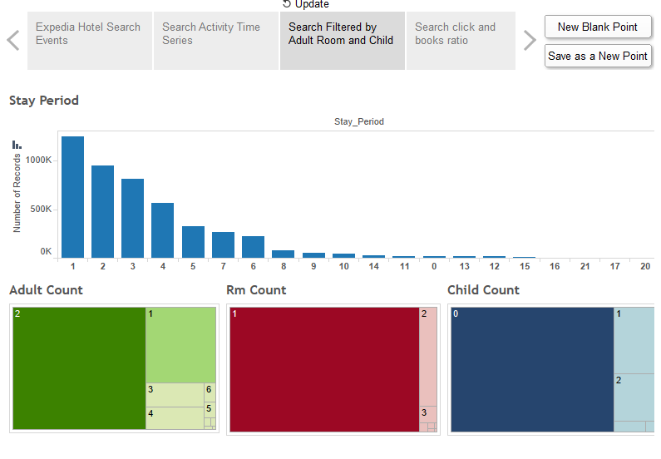
Data Visualization
Tools Used: Tableau and Power BI
Performed different kind of Analysis based on
User Analysis
Hotel Analysis

Slide 6
Modeling
Tools Used: Azure ML, Python and Alteryx
We have implemented models:
One vs All + Boosted Trees
Multiclass Decision Forest
Multiclass Decision Jungle
Multiclass Logistic Regression
Multiclass Neural Network

Slide 7
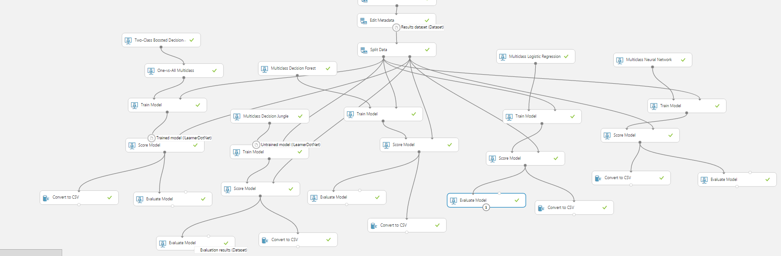

Slide 8
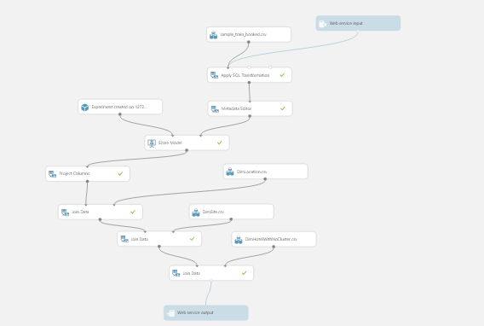

Slide 9
Deployment
Tools Used: Python Server, Flask Framework, Bootstrap, HTML5, CSS3,Jquery, REST API
Create Website for User Input
Redirecting
Deployment of Web Service

Slide 10
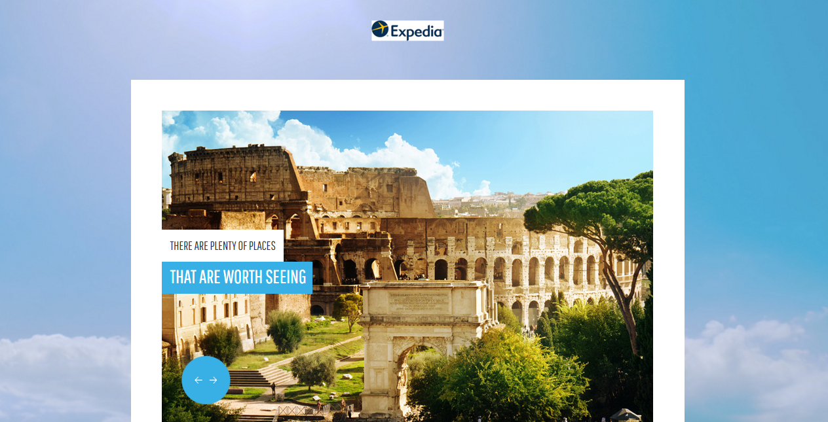
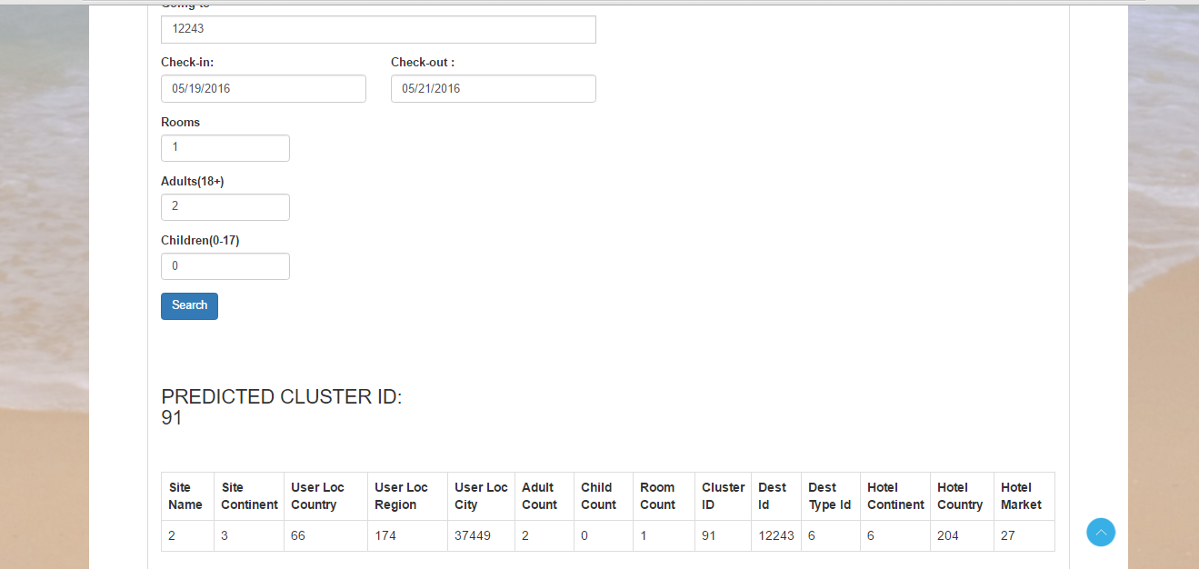

Slide 11
Q & A

